Slide 1
Elasticity
Capstone Unit 2, Lesson 12

Slide 2
Objectives
1.Analyze price as a factor influencing people‘s choices.
2. Recognize that different product characteristics, real and perceived, influence people’s consumption and supply responses to price change.

Slide 3
definition
Price elasticity of demand is the relative response of quantity demanded to changes in demand price.

Slide 4
3 determinants
Availability of substitutes
Time period
Budget proportion

Slide 5
Price elasticity of demand
(Q2-Q1)/[(Q1+Q2)/2]
(P2-P1)/[(P1+P2)/2]

Slide 6
Insulin
(Q2-Q1)/[(Q1+Q2)/2]
(P2-P1)/[(P1+P2)/2]
Q1 = 12 injections per week
Q2 = 14 injections per week
P1 = $20.00 per injection
P2 = $10.00 per injection
.23

Slide 7
(Q2-Q1)/[(Q1+Q2)/2]
(P2-P1)/[(P1+P2)/2]
Q1 = 1 quart per week
Q2 = 3 quarts per week
P1 = $2.50 per quart
P2 = $2.25 per quart
9.52

Slide 8
>1 elastic demand
Lots of substitutes
<1 inelastic demand
Few substitutes
=1 unit elastic

Slide 9
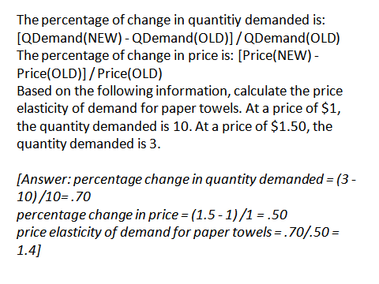

Slide 10
Objective

Slide 11
Total Revenue is: price x quantity demanded

Slide 12
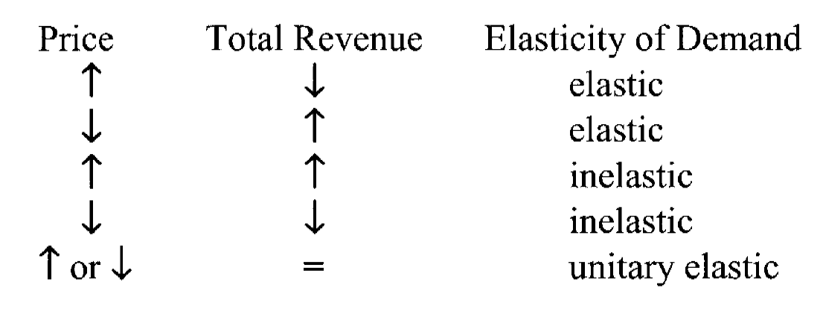
Total Revenue Test

Slide 13
Inelastic supply
Products take a long time to produce
Jets
Depend upon techniques or hard to find skills
Hand crafted instruments
Cannot increase production rapidly
Apple farm (takes years to grow trees)

Slide 14
Elastic supply
Easy to produce
Require little or no skill
Use easily acquired resources
The most important factor determining price elasticity for supply is TIME

